Slide 1

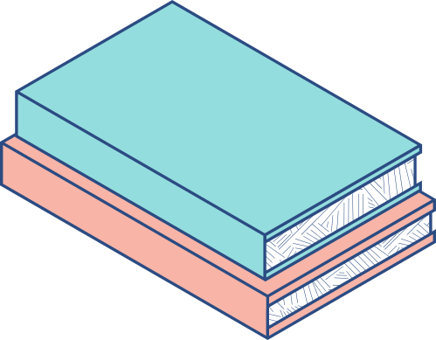




TLRC TALK / DECEMBER 6, 2023 COMMON HOUR
Don't Fear the Beast: Unleashing Chat-GPT in the Classroom*
(*this title was generated by Chat-GPT)
Dr. Jessica L. Williams, English Department
Joined by Multi-Ethnic US Literature Students:
Nimrah Muzaffar, Mallory Vannoni, and
Jaeda Wallick.

Slide 2

I am not an expert on AI
I can only speak to my ideas about and experiences using AI specifically in literature and writing classrooms
PLEASE NOTE!

Slide 3
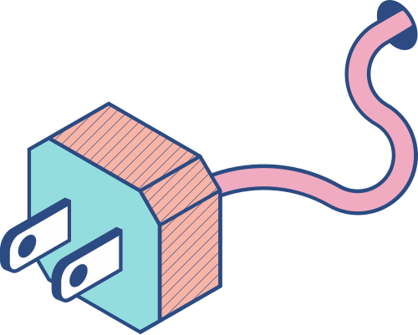
First Impressions
omg
this is a nightmare
no more out of class writing
we have to ban it!
catch all the students + fail them all for plagiarism
it’s the demise of higher education
we’re all doomed

Slide 4
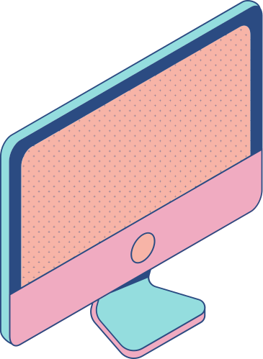


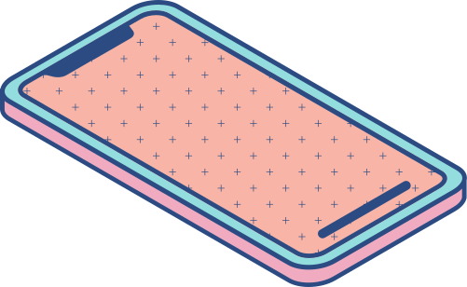
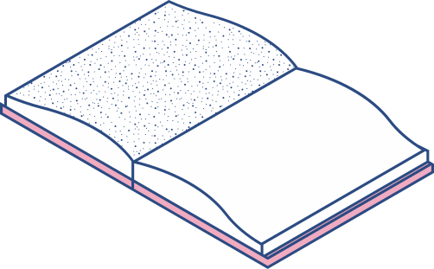
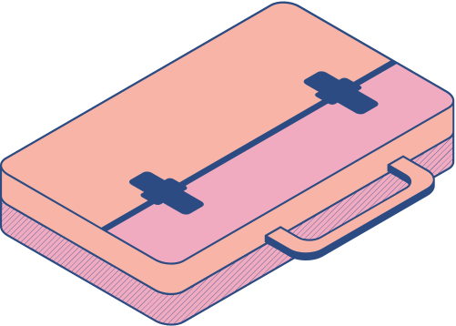
HOW MIGHT WE EMBRACE AI IN THE CLASSROOM RATHER THAN FEAR IT?
HOW MIGHT WE USE AI AS A TOOL: LIKE A CALCULATOR, WIKIPEDIA, GOOGLE, OR A STUDY BUDDY?
I BELIEVE IN EMBRACING NEW TECHNOLOGIES, BUT WHERE DO WE DRAW THE LINE? THE GOAL IS TO IMPROVE LEARNING, SELF-RELIANCE, AND SELF-ASSESSMENT, AND TO BUILD KNOWLEDGE, NOT TO GIVE STUDENTS DETOURS AROUND CRUCIAL SKILL BUILDING.
At a Crossroads

Slide 5
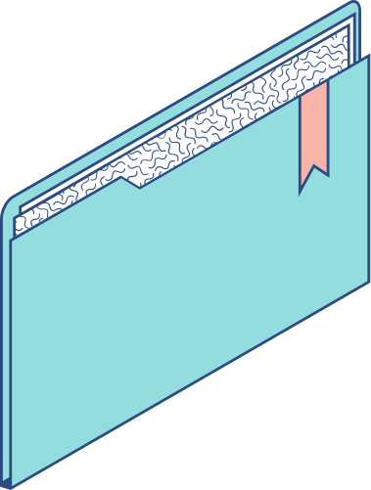
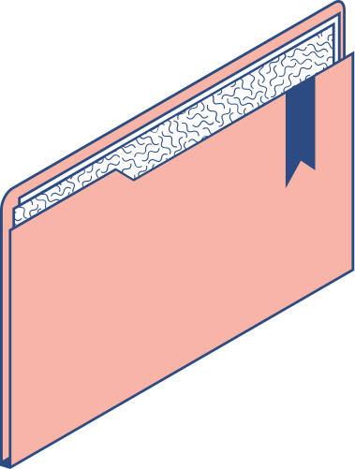
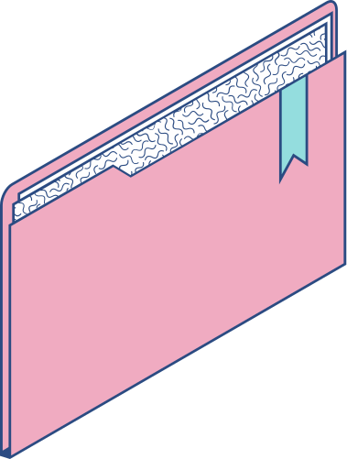
“Academia really has to look at itself in the mirror and decide what it’s going to be,” said Josh Eyler, director of the Center for Excellence in Teaching and Learning at the University of Mississippi, who has criticized the “moral panic” he has seen in response to ChatGPT. “Is it going to be more concerned with compliance and policing behaviors and trying to get out in front of cheating, without any evidence to support whether or not that’s actually going to happen? Or does it want to think about trust in students as its first reaction and building that trust into its response and its pedagogy?” From Beth McMurtrie, “AI and the Future of Undergraduate Writing: Teaching experts are concerned, but not for the reasons you think” (The Chronicle of Higher Education, 12/2022)
Tip: Use links to go to a different page inside your presentation.
How: Highlight text, click on the link symbol on the toolbar, and select the page in your presentation you want to connect.

Slide 6
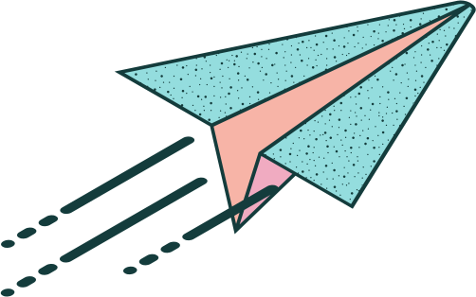
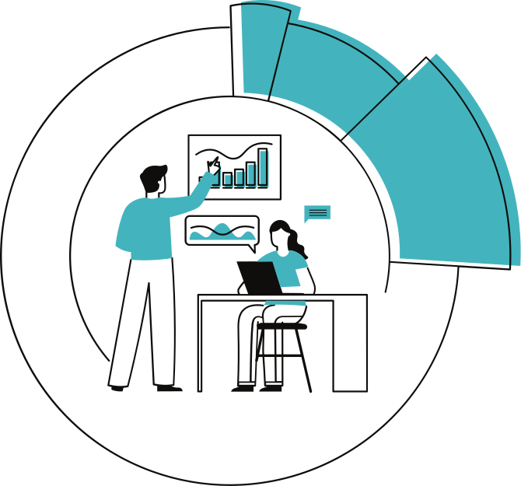
Aha Moment!
Don’t Fear the Beast
(and maybe it’s not a beast at all)
AI detection tools don’t work and I do not want my life, as someone who teaches writing, to become a crusade against AI generated material.
Therefore, the question for me became: how can I embrace it, and use it to build skills that I would typically teach in more traditional ways?
When I stopped being so fearful of student cheating, it led me to experiment with taking a more "permissive" or "experimental " approach to AI in my classes instead of villainizing it. This has led to significantly fewer cases of “AI generated plagiarism” and has illustrated to students how to work with contemporary learning tools in a responsible way.

Slide 7
MLA Guidelines:
cite a generative AI tool whenever you paraphrase, quote, or incorporate into your own work any content (whether text, image, data, or other) that was created by AI
acknowledge all functional uses of the tool (like editing your prose or translating words) in a note, your text, or another suitable location
take care to vet the secondary sources it cites
HOW
CITE
TO
MLA 9 In-text Citation:
When asked to describe the symbolism of the green light in The Great Gatsby, ChatGPT provided a summary about optimism, the unattainability of the American dream, greed, and covetousness. However, when further prompted to cite the source on which that summary was based, it noted that it lacked “the ability to conduct research or cite sources independently” but that it could “provide a list of scholarly sources related to the symbolism of the green light in The Great Gatsby” (“In 200 words”).
MLA 9 Works-Cited-List Entry:
“Describe the symbolism of the green light in the book The Great Gatsby by F. Scott Fitzgerald” prompt.
ChatGPT, 13 Feb. version, OpenAI, 8 Mar. 2023, chat.openai.com/chat.
https://style.mla.org/citing-generative-ai/

Slide 8

AI REVISION ASSIGNMENT INSTRUCTIONS: READ EVERYTHING I NEVER TOLD YOU PAGES 124-157. THEN, FOLLOW THE INSTRUCTIONS BELOW TO COMPLETE YOUR AI ASSIGNMENT: | AI REVISION ASSIGNMENT INSTRUCTIONS: READ EVERYTHING I NEVER TOLD YOU PAGES 124-157. THEN, FOLLOW THE INSTRUCTIONS BELOW TO COMPLETE YOUR AI ASSIGNMENT: | AI REVISION ASSIGNMENT INSTRUCTIONS: READ EVERYTHING I NEVER TOLD YOU PAGES 124-157. THEN, FOLLOW THE INSTRUCTIONS BELOW TO COMPLETE YOUR AI ASSIGNMENT: | AI REVISION ASSIGNMENT INSTRUCTIONS: READ EVERYTHING I NEVER TOLD YOU PAGES 124-157. THEN, FOLLOW THE INSTRUCTIONS BELOW TO COMPLETE YOUR AI ASSIGNMENT:
Write a one-paragraph analysis of any 1-2 sentence quote from EINTY pgs 124-157. Go to ChatGPT (you will need a free account if you don't already have one). Type in the following prompt: "Can you revise the following paragraph for me?" and then copy and paste in your one paragraph analysis. Chat GPT will generate a revision of your paragraph. Review ChatGPTs revisions and decide which changes make your paragraph better and which don't improve it. Save Chat GPT’s response by copying and pasting it into a separate document. Revise your paragraph using some, all, or none of ChatGPTs suggestions. CITE ANYTHING THAT COMES FROM CHATGPT. Write 3-4 sentences reflecting on ChatGPTs suggestions, which you kept—some, all, none—and why. | Write a one-paragraph analysis of any 1-2 sentence quote from EINTY pgs 124-157. Go to ChatGPT (you will need a free account if you don't already have one). Type in the following prompt: "Can you revise the following paragraph for me?" and then copy and paste in your one paragraph analysis. Chat GPT will generate a revision of your paragraph. Review ChatGPTs revisions and decide which changes make your paragraph better and which don't improve it. Save Chat GPT’s response by copying and pasting it into a separate document. Revise your paragraph using some, all, or none of ChatGPTs suggestions. CITE ANYTHING THAT COMES FROM CHATGPT. Write 3-4 sentences reflecting on ChatGPTs suggestions, which you kept—some, all, none—and why. | Write a one-paragraph analysis of any 1-2 sentence quote from EINTY pgs 124-157. Go to ChatGPT (you will need a free account if you don't already have one). Type in the following prompt: "Can you revise the following paragraph for me?" and then copy and paste in your one paragraph analysis. Chat GPT will generate a revision of your paragraph. Review ChatGPTs revisions and decide which changes make your paragraph better and which don't improve it. Save Chat GPT’s response by copying and pasting it into a separate document. Revise your paragraph using some, all, or none of ChatGPTs suggestions. CITE ANYTHING THAT COMES FROM CHATGPT. Write 3-4 sentences reflecting on ChatGPTs suggestions, which you kept—some, all, none—and why. | Write a one-paragraph analysis of any 1-2 sentence quote from EINTY pgs 124-157. Go to ChatGPT (you will need a free account if you don't already have one). Type in the following prompt: "Can you revise the following paragraph for me?" and then copy and paste in your one paragraph analysis. Chat GPT will generate a revision of your paragraph. Review ChatGPTs revisions and decide which changes make your paragraph better and which don't improve it. Save Chat GPT’s response by copying and pasting it into a separate document. Revise your paragraph using some, all, or none of ChatGPTs suggestions. CITE ANYTHING THAT COMES FROM CHATGPT. Write 3-4 sentences reflecting on ChatGPTs suggestions, which you kept—some, all, none—and why.

Slide 9

Their original paragraph
A copy of ChatGPT's response
Their revised paragraph (with citations and a works cited page if they used any of the AI suggestions!!!)
A reflection on what they changed and why
Students Submit the following:

Slide 10
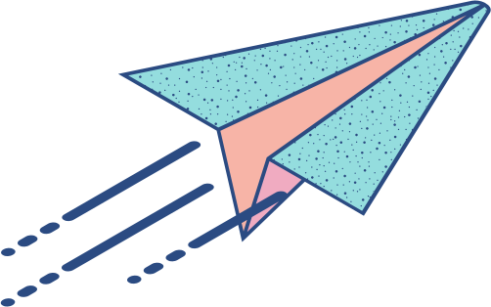
Student Experiences!!!
Nimrah Muzaffar, Adolescence Ed: Social Studies
Jaeda Wallick, English
Mallory Vannoni, English

Slide 11

Other Ideas for AI Use in the Classroom
Beat the Bot Challenge!
generating a step by step to do list for an assignment
generating thesis statements
giving feedback on wording of a phrase, sentence or short selection of text
writing an outline
coming up with ideas for topics
generating ideas for paper titles
mimicking peer review
feed students’ work into AI and generate a quiz

Slide 12
My Current POV:
Students are still thinking when they use AI; they’re just thinking differently than we had to and not only is this okay, maybe this is exactly what they need to become advanced critical thinkers in a rapidly changing world.

